Slide 1
Apple’s Design Philosophy and Principles
Meher Shashwat Nigam (20171062)
Anoushka Vyas (20171057)

Slide 2
Contents
Overview
Motivation
What do we hope to achieve?
Apple Product Design in a nutshell
Thing you never knew or didn’t notice
Market Trends

Slide 3
Overview
We aim to study Apple’s design philosophy and how it successfully created a brand name that’s synonymous with great design.
We want to explore what design principles Apple products incorporate and connect them with Don Norman’s User centered design principles.
Additionally,
Try to understand how apple products have now become a status symbol, a luxury brand name.
How Apple has successfully created its own separate market with a ‘family’ of appliances and products, that are only compatible with each other.

Slide 4




Motivation
The never ending battle of brand supremacy !
Status symbol? Performance? Camera Quality? Pricing ?
Design ! What’s your pick?
We started off by comparing Apple as a mobile phone brand but soon realized that it has completely revolutionized the way product design itself is perceived, raising the expectations of users.

Slide 5
What do we hope to achieve?
By the end of our study we want to be able to:
Understand user focused product design principles* through principles of human computer interaction.
What promotes consumers to choose a particular product*.
Additionally try to gain insight into:
How to create a brand name/ image
* (focused on electronics: laptops, mobile phones, pads in context of Apple products)

Slide 6
Apple Product Design in a nutshell
Simplicity and minimalistic : Apple products have one of the most intuitive and simplest UI out there because complex designs tend to overwhelm users. This is one of the main reasons why it commands such loyalty from users, even when the price tag remains steep. According to Don Norman, the most important characteristics of a good design are : discoverability and understanding.
Distinctive design : Clean, friendly and fun. Successful combination of aesthetic design without compromising functionality. As Steven Bradley says, “Human beings have an attractiveness bias; we perceive beautiful things as being better, regardless of whether they actually are better”.
Attention to detail : By working closely with manufacturers, Apple is able to keep a tight rein on its quality control and it is able to prevent cheap and subpar materials from entering the process and becoming part of the finished product.
Well-structured product design process : A design team only has around 12 to 20 people, and this limit is advantageous in keeping the team focused. Willingness to put its products through successive design iterations, to stay up to date with new technology and expectations of people.
https://www.cleverism.com/apple-product-design/

Slide 7
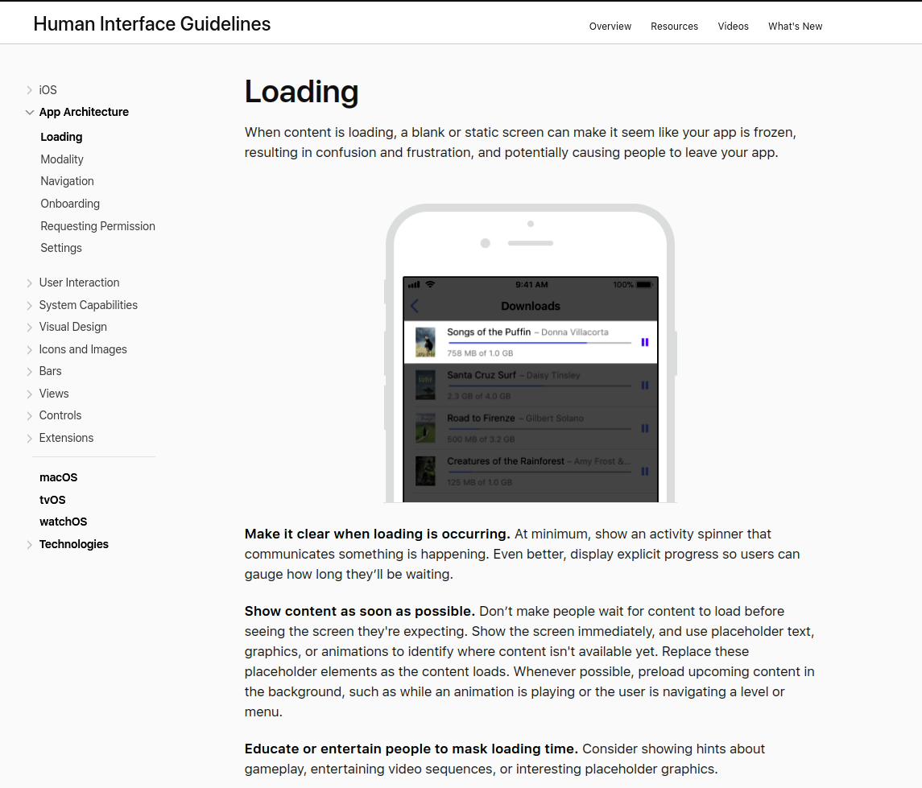
An example in the User interface guidelines
Apple has its own set of Human interface guidelines set for its iOS, macOS application developers so that a ‘fluid’ and ‘uniform’ experience is maintained.
This example is an instance of user engagement which is critical according to Don Norman. According to him its necessary to have a feedback mechanism, which informs about the ongoing functions of the device, which must be immediate and should be in such a way that keeps the user engaged.
https://developer.apple.com/design/human-interface-guidelines/ios/app-architecture/loading/

Slide 8
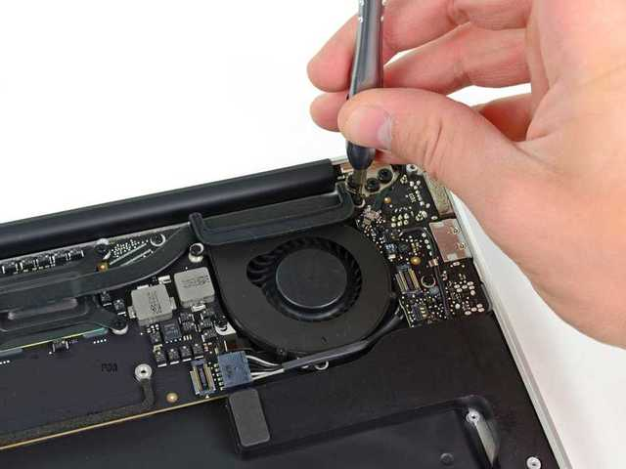

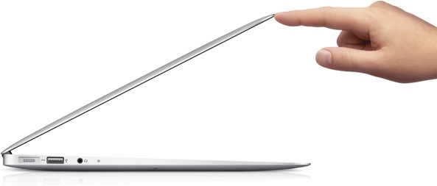
Things you never knew or didn’t notice
When engaging the voice dictation feature on newer Mac laptops, Apple automatically slows the internal fan speed to better hear your voice.
After people got used to using an iPhone's slide-to-unlock button, Apple removed the arrow button and guiding rail. While the new version is much more minimal, Apple still guides new users in the left-to-right motion by causing the text instructions to shine from left to right.
Apple designs its laptops so they can be opened with just one finger, thanks to that special groove on the front lip. It's worth noting that new devices can take some time to break in before it works.
https://www.businessinsider.in/21-tiny-design-features-that-show-Apples-incredible-attention-to-detail/A-breathing-sleep-light/slideshow/51856058.cms

Slide 9
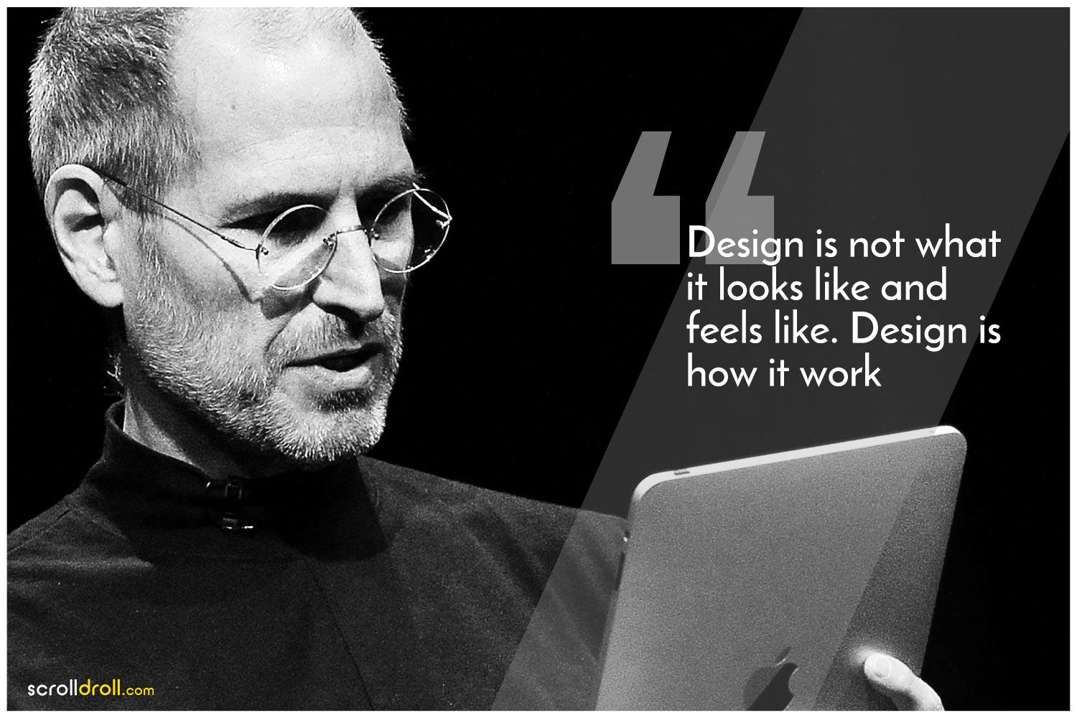
The man behind it all: Steve Jobs
Studying Apple’s design philosophy is incomplete without him. It was Steve Jobs outlook and fanatic attention to detail and symmetry that made the brand what it is today.
Jobs’ love of simplicity in design was honed when he became a practitioner of Buddhism. After dropping out of college, he made a long pilgrimage through India seeking enlightenment, but it was mainly the Japanese path of Zen Buddhism that stirred his sensibilities.
https://www.smithsonianmag.com/arts-culture/how-steve-jobs-love-of-simplicity-fueled-a-design-revolution-23868877/

Slide 10
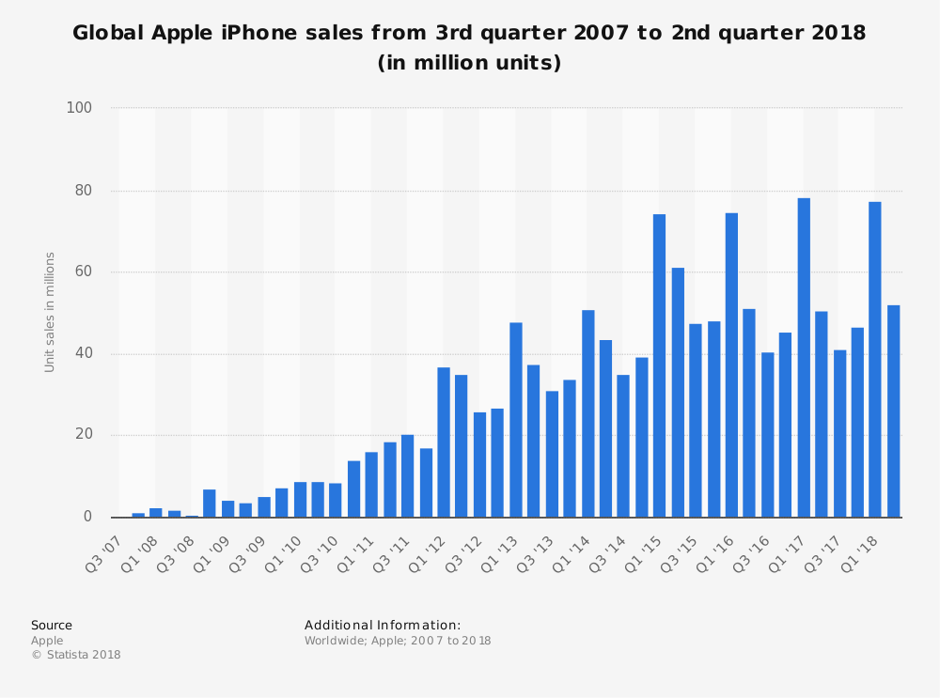
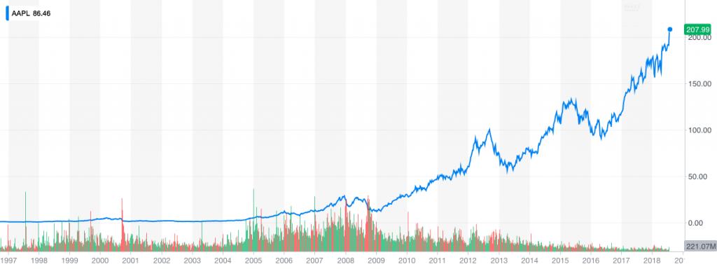
Market trends
87%
Apple has sold over 1.3 billion iPhones since launch (2007).
Since 2001, Apple’s stock price has grown by 15,000% making the company worth $1 trillion.
Apple sells 18% of smartphones globally and earns 87% of smartphone profits.
Profit share
18%
Smartphone sales globally
https://mediakix.com/blog/apple-statistics/

Slide 11

Thank you!

